Slide 1


What's What and Who's Who? Cross System Record Linkage in Fabric

Slide 2






About Me

Slide 3
Splink a brief history
Approaches to matching
Deterministic
Fuzzy
Probabilistic
Comparisons
Weightings
Blocking
Tempt the Demo Gods
Notes:
Finish – 3:00

Slide 4

Be fast enough to link upwards of 100 million records
Have a transparent methodology that can be explained by the team, and understood by users
Be as high accuracy as possible given data quality
Be flexible enough to accommodate a wider variety of input data and link multiple data sets together
Notes:
Start – 3:00

Slide 5
Released
v1 – 2020
v3 – 2022
v4 - 2024
Runs on
DuckDB
Spark (inc. Synapse, Fabrc and Databricks)
Amazon Athena, SQLite,PostgreSql
Notes:
Finish – 7:00

Slide 6

Deterministic Matching
Barney = Barney
Barney <> Barnie
Barney <> Barnabas
Notes:
Start - 7:00
Finish – 9:00

Slide 7

Fuzzy Matching
Lawrence = Lawrence
B | A | R | N | E | Y
B | A | R | N | E |  |  | 1
B | A | R | N | I | E |  | 2
Notes:
Start - 9:00
Finish – 11:00

Slide 8
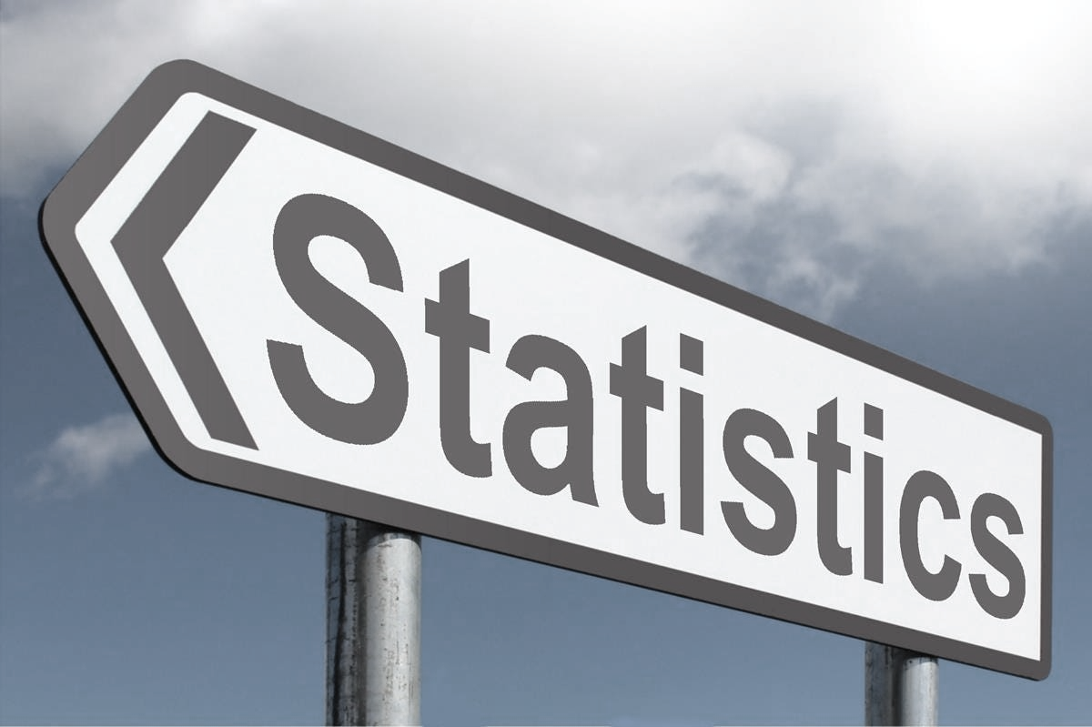
Probabilistic Matching
Notes:
Start - 11:00

Slide 9
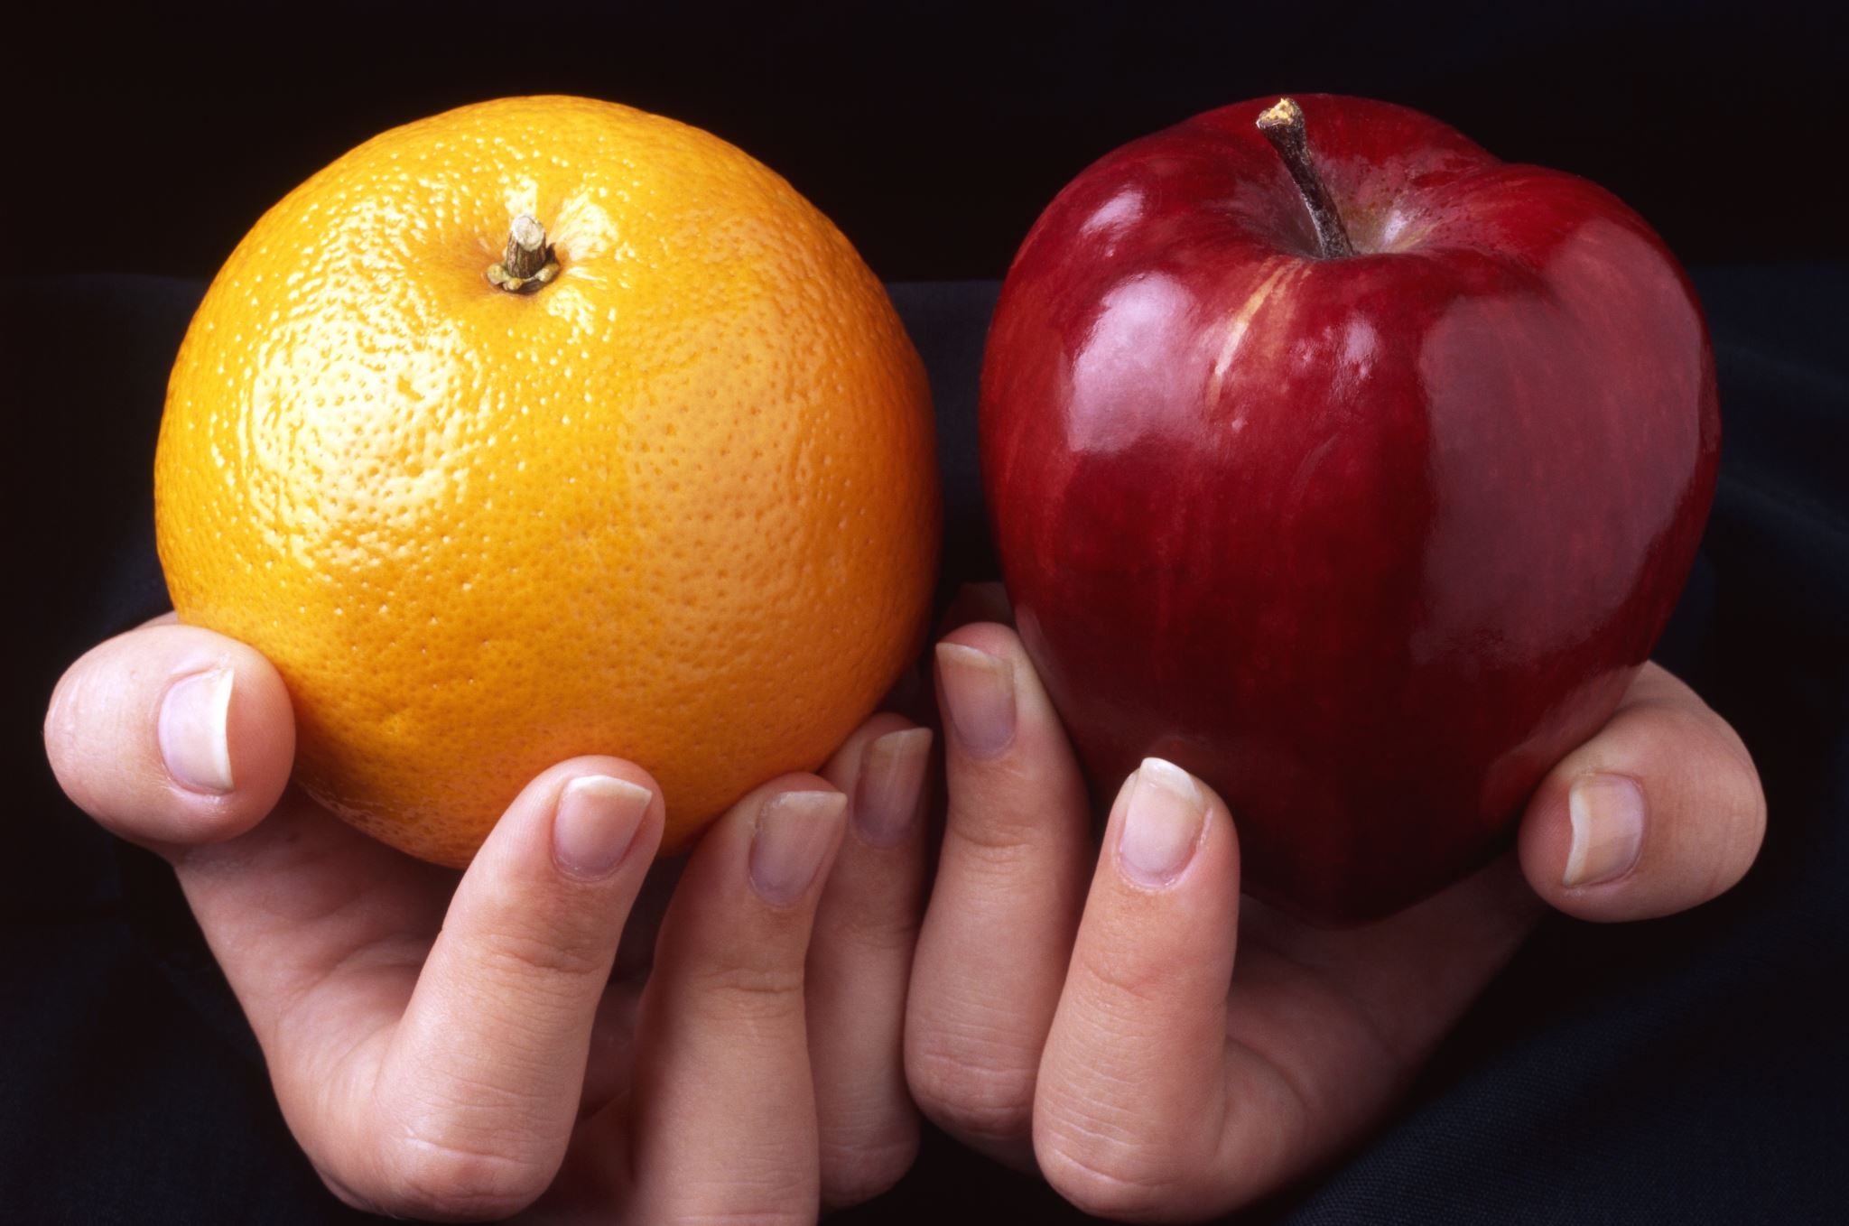
Comparisons
Notes:
Start - 13:00
Finish - 16:00

Slide 10
cl.exact_match("first_name")
Left.first_name = Right.first_name
Left.first_name <> Right.first_name
Left.first_name IS NULL OR Right.first_name IS NULL

Slide 11
ctl.postcode_comparison("Postcode")
Postcode | AA9 9AA
Sector | AA9 9
District | AA9
Area | AA
NULL | ?=?
Other | (no match)

Slide 12
ctl.name_comparison(
“FirstName",
include_exact_match_level=True,
damerau_levenshtein_thresholds=[2],
jaro_winkler_thresholds=[0.9, 0.8],
term_frequency_adjustments=True
),

Slide 13
Damerau-Levenshtein Distance
B | A | R | N | E | Y
B | A | R | N | E |  |  | 1
B | A | R | N | I | E |  | 2
Notes:
Start - 16:00
Finish – 22:00

Slide 14
Jaro Winkler
Similarity to Barney | Score
Barnie | 93.3%
Barry | 87.6%
Barnabas | 83.3%
Morney | 77.8%

Slide 15
Term Frequency
Noah – 1 in 71
Oliver – 1 in 77
Muhammad/Mohammed/Mohammad – 1 in 53
William – 1 in 153
Michael – 1 in 427
Barney – Did not rank

Slide 16
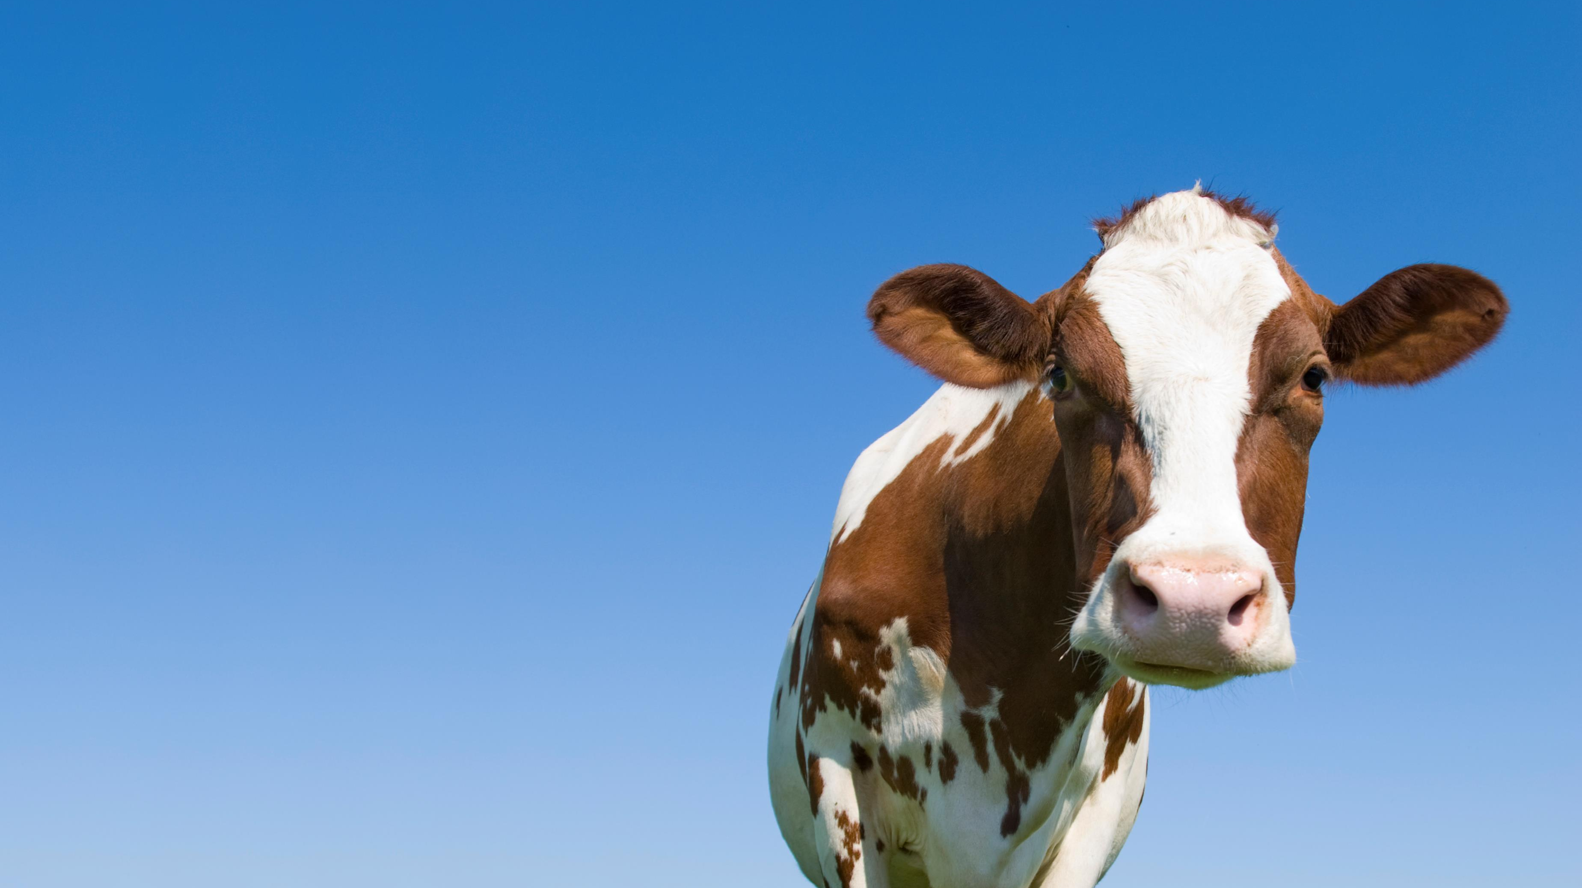
Weightings
Notes:
Start - 22:00
Finish 27:30

Slide 17



Slide 18



System A
System B
≠

Slide 19

System A
System B
=

Slide 20
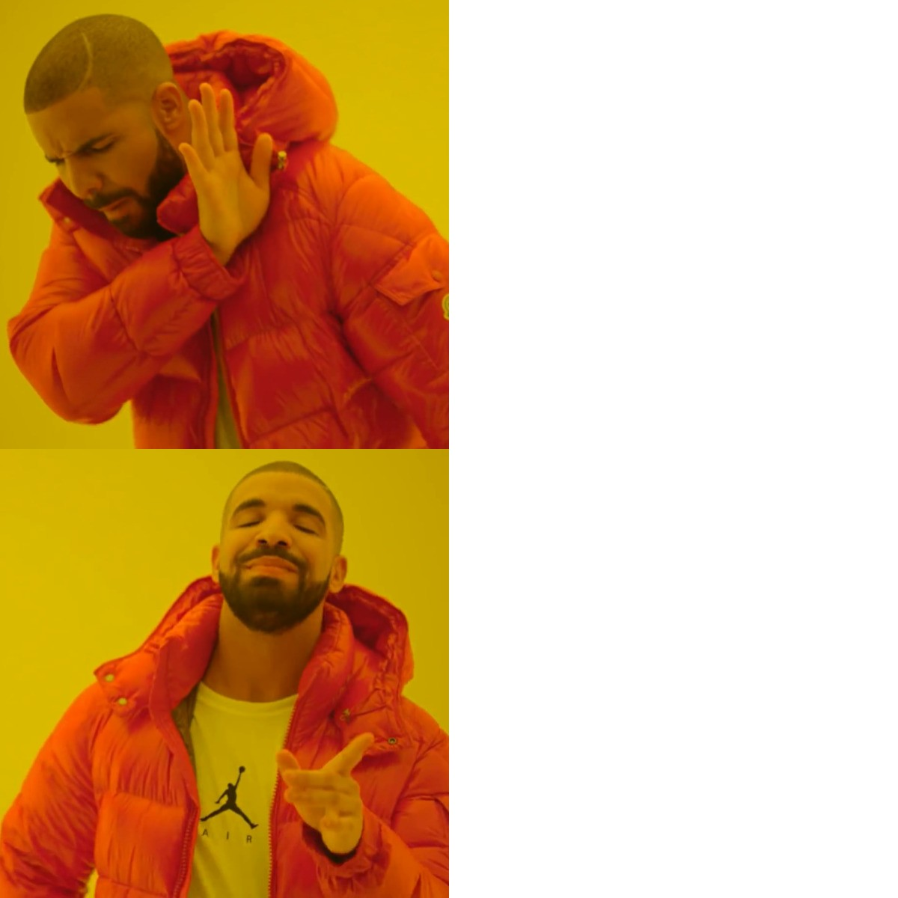
Left = Right
M is high
U is low
Left <> Right
U is high
M is low

Slide 21
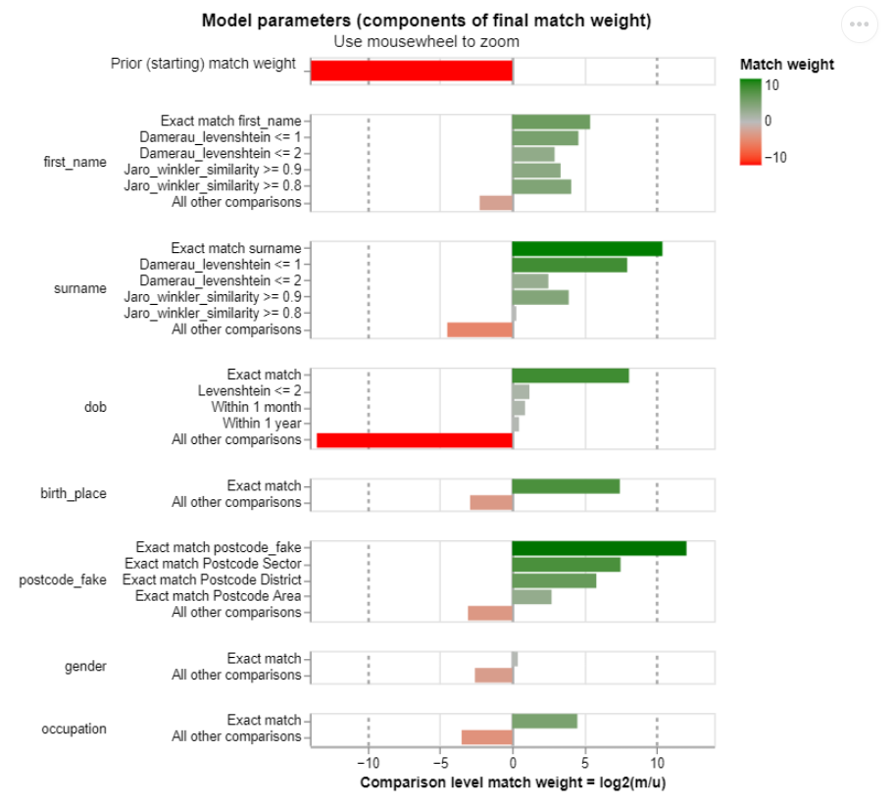

Slide 22
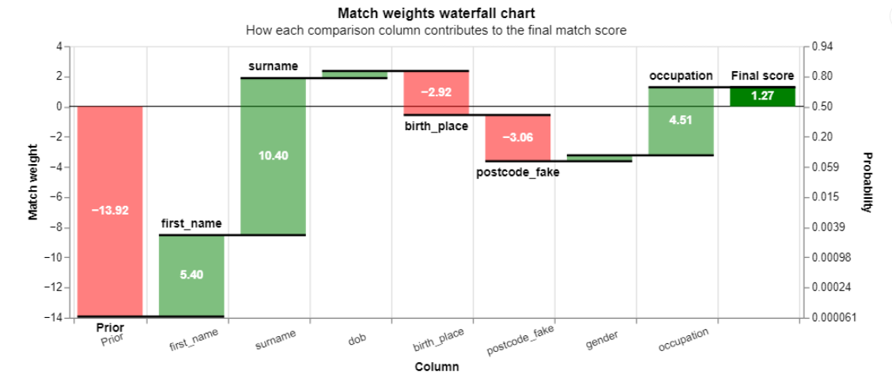

Slide 23
1,000,000 x 1,000,000
1,000,000,000,000
Notes:
Start – 27:30
Finish – 29:00

Slide 24
 | A | B | C | D | E | F | G
A
B
C
D
E
F
G

Slide 25
 | A | B | C | D | E | F | G
A
B
C
D
E
F
G

Slide 26
 | Jan | Feb | Mar | Apr | May | Jun | Jul
Jan
Feb
Mar
Apr
May
Jun
Jul

Slide 27

Blocking
"blocking_rules_to_generate_predictions": [
brl.exact_match_rule("LastName"),
brl.exact_match_rule("Forename"),
brl.exact_match_rule("Postcode"),
brl.exact_match_rule("DateOfBirth")
]

Slide 28
Blocking Worked Example
Social Care – 400,000
Education – 110,000
Blocking | Combinations
None | 44 Billion
Last Name | 43 Million
Forename | 45 Million
Date of Birth | 767 Thousand
Postcode | Million
Blocking Total | 94 Million

Slide 29

Here Comes the (Data) Science Bit
Estimate the number of matches we expect to find
Sample random pairs to estimate U
Train on known exact matches to generate M
Train on chosen blocks refine M
Apply weightings to pairs in blocks and create matches
Process matches to find the best ones and set a minimum threshold

Slide 30

Thank You For Listening
Barney
aka Barnabas
aka Barry
aka Bonnie
aka Bernie
aka Honey

